Slide 1
Webomberchicken456
team_unity_3d_2
Minh Le, Viet Huy Vu, Tin Vuong

Slide 2
About Us
Team:
Minh: Sophomore CS, C++ and Python, No experience with game engines
Tin: Sophomore CS, C++ and Python, more interested in cybersecurity but games are cool too.
Huy: Sophomore CS, C++ and Python, enjoy doing coding exercise online.
Main Operating System: Windows
Tin uses MacOS
Meeting Times: Saturday 2:00 - 5:00 P.M

Slide 3
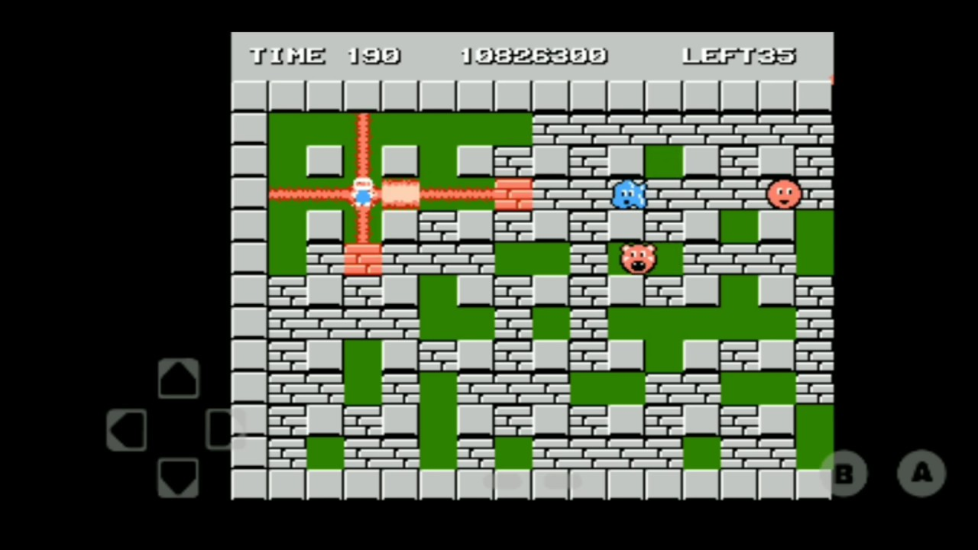
About Our Project
Bomberman Ripoff using Unity 2D engine. Bomberman is an action maze game!
Tools: Unity, Unity Shop, GitHub, Visual Studio, VS Code.
Extra Tools: Piskel (online sprite maker), FL Studio (Audio Design).
Technology Stack: Unity libraries.
End Goal: Using bomberman’s core mechanic to make a game that involved spawning minions, same device multiplayer and capture the flag style gameplay
(In an ideal world: our own design texture, Soundtrack, Multiplayer, Storyline, Cutscenes)

Slide 4
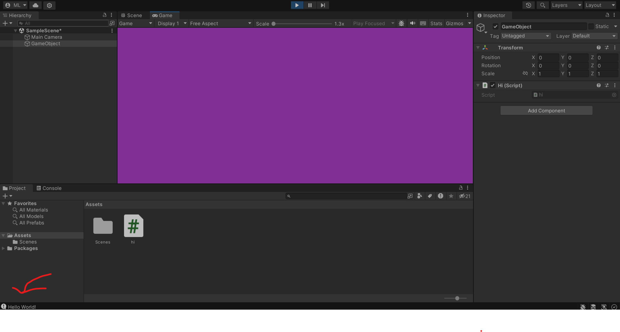
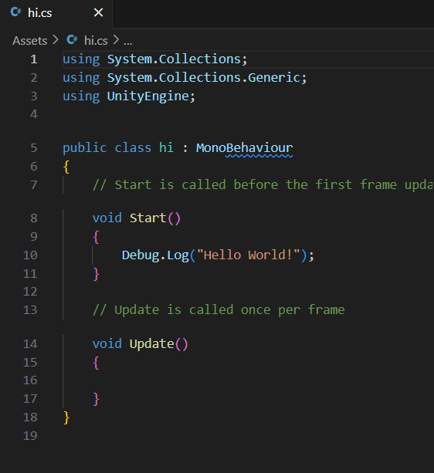
Hello World

Slide 5
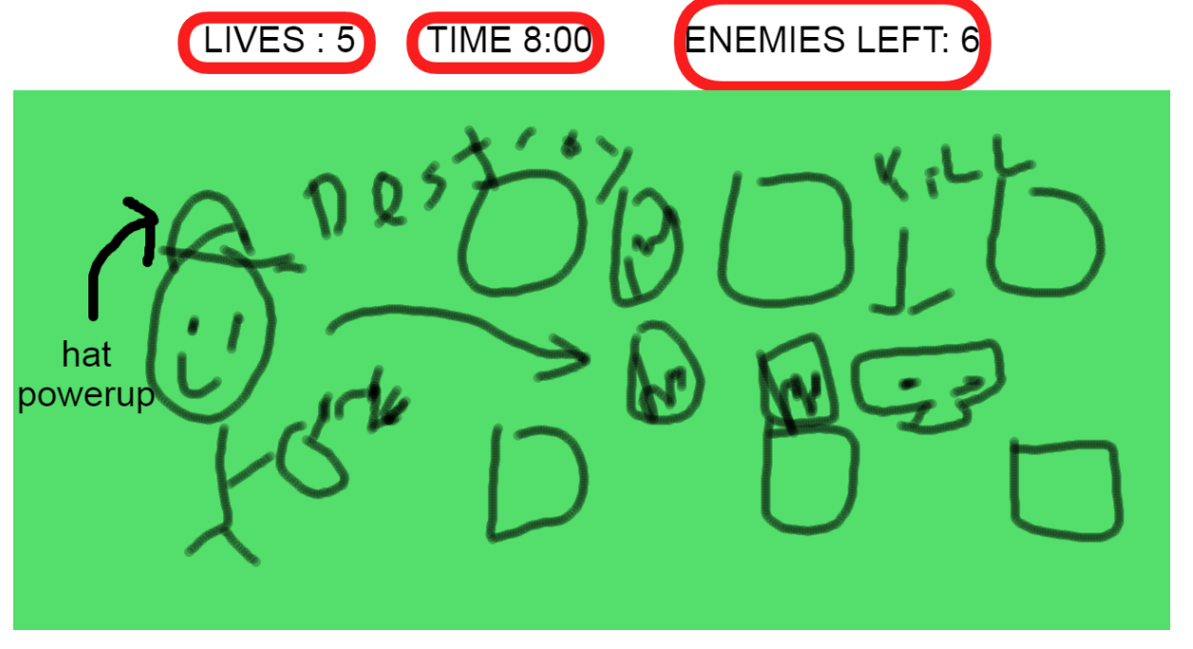
Main Game GUI

Slide 6
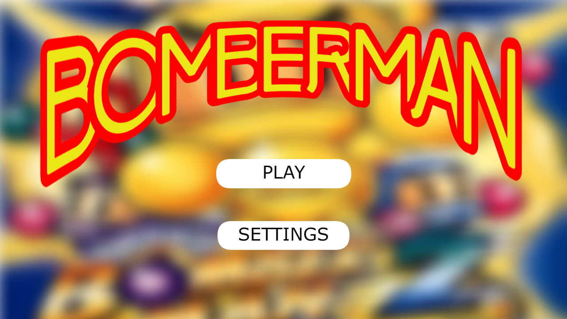
Title Screen

Slide 7
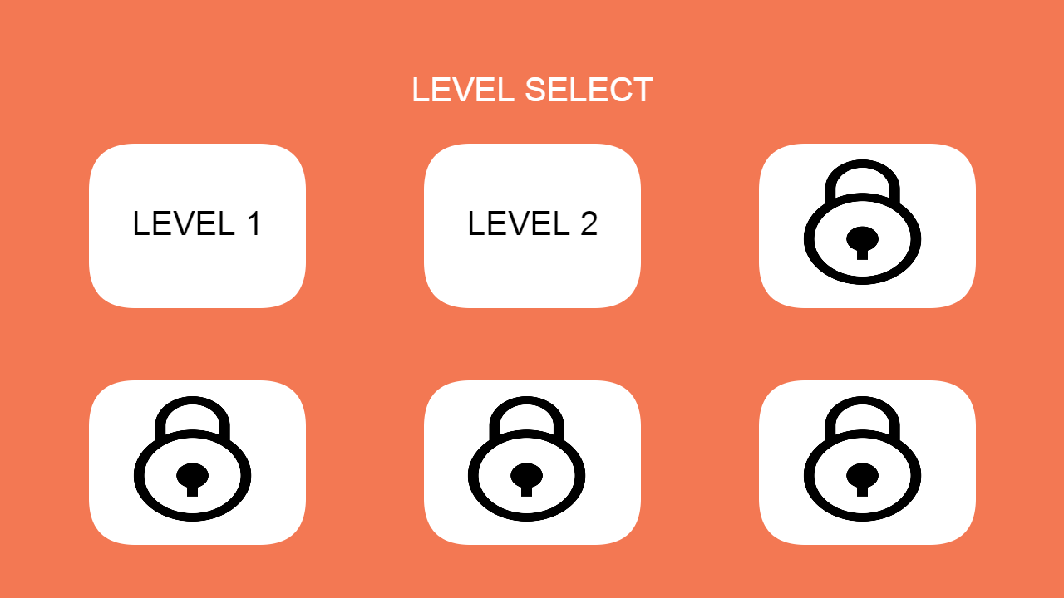
Level Select

Slide 8
Checkpoint 1

Slide 9
Past Work Summary
Minh - Watched videos on how 2D maps are created in Unity. Added tile map layout and sprites.
Huy - Researched how to move characters. Added simple movement to playable character.
Tin - Researched how enemy AI works in Unity. Added enemy sprites into the game.

Slide 10
Next Checkpoint Plan
Tin: Make enemy bots move by themselves.
Already has knowledge from previous meeting
Huy: Implement bomb mechanic script.
Is more familiar with character functionality.
Minh: Implement breakable blocks script.
Has a better understanding on map layout
Potential Roadblocks:
Enemy movements are tough to implement, maybe not even next meeting….
If bomb script doesn’t work then breakable block script will not work.

Slide 11
Grading Items

Slide 12
Meeting Attendance Sheet
2/07/2024 – Tin missed (was sick)
2/10/2024 – All members attended

Slide 13
Minh Le Contributions
Researched and started building the map for the game
Report:
In Unity there is a thing called a tile map which is a tool that stores tile assets and also creates the map. A map can easily be created by drawing out the map onto the unity grid. There are also other options such as adding C# scripts and collision components. Collision is an important component since it tells the map if the player can interact with the pieces of the map or not. C# scripts are important for implementing special behaviors for the map. I haven’t gone too deep into scripts yet, that will be for the next meeting.

Slide 14
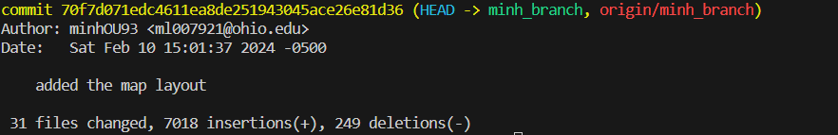
Minh Le (ml007921/minhOU93) - Commit 1
https://github.com/OU-CS3560/s24-unity3d-2/commit/70f7d071edc4611ea8de251943045ace26e81d36

Slide 15
Tin Vuong
Contributions
Began research on enemy movements and AI
Added enemy sprites
C# scripts are the way to make enemies move. There is a class called EnemyController which should be where I implement movement scripts. Prefabs are also useful to save enemy types whenever they are needed.
Commit was not merge to main because enemies disrupted the map.

Slide 16
Viet Huy Vu
Contributions
Started researching about player movements and added basic player movements
Things I learn:
KeyCode is the C# class for gathering input.
Gravity is there by default when creating player movement in Unity. Unity has a lot of extra things so a .gitignore is required to incorporate GitHub into version control for a Unity Project. I have now become better at solving conflict between git version.

Slide 17
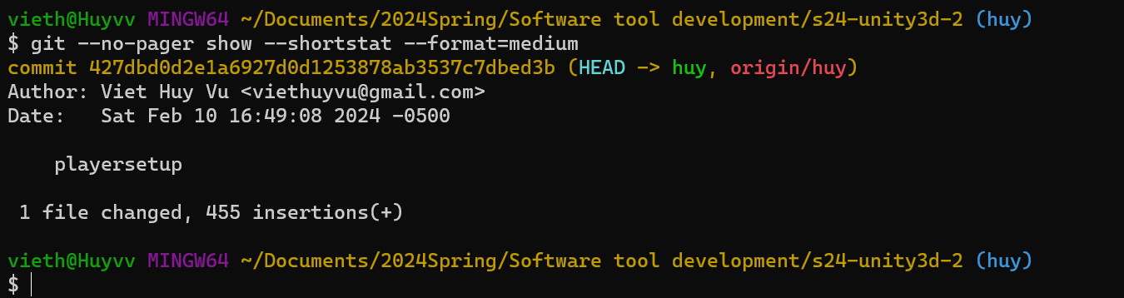
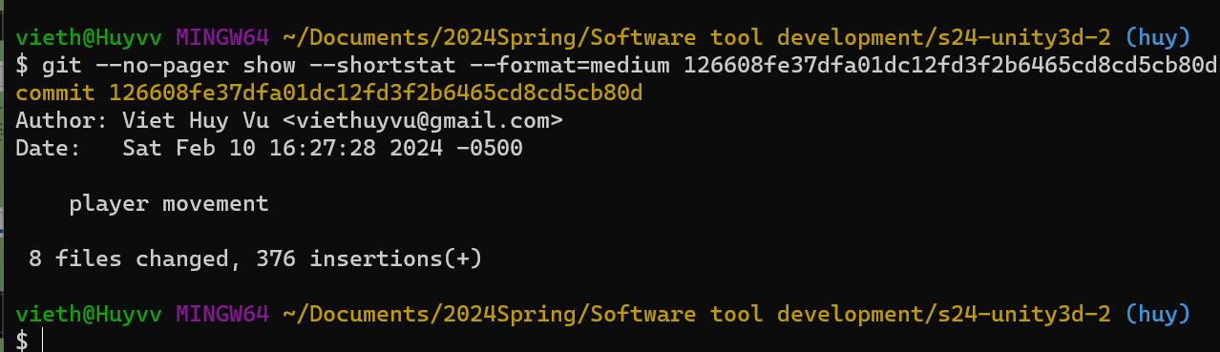
Viet Huy Vu (vv761622/viethuyvu) - Commits
playersetup · OU-CS3560/s24-unity3d-2@427dbd0 (github.com)
player movement · OU-CS3560/s24-unity3d-2@126608f (github.com)

Slide 18
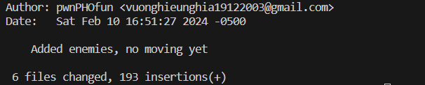
Tin Vuong (nv059721/wechicken456) - Commit 3
https://github.com/OU-CS3560/s24-unity3d-2/commit/ce7bb68aa859e557f6d7f2a95f80e18119083db6

Slide 19
Checkpoint 2

Slide 20
Past Work Summary
Minh - Added animation script, added breakable blocks.
Huy - Worked on player movement, bomb placing, explosion and death state.
Tin - Made enemies move using pathfinding library.

Slide 21
Next Checkpoint Plan
Tin: Polish enemy movement. Different enemy type
Has been working on enemies.
Huy: Finishing death state for enemy and player
Started working on death state
Minh: Re-edit sprite and assets
Has the best “art skill” in the group
Potential Roadblocks:
Art skill not the best
Trying to add more new ideas so less reference available

Slide 22
Grading Items

Slide 23
Meeting Attendance Sheet
2/07/2024 – Tin missed (was sick)
2/10/2024 – All members attended
2/16/2024 - All attended
2/25/2024 - All attended

Slide 24
Minh Le Contributions
Added breakable blocks, and global animation script
Report:
In a video I watched, they created a global animation script that could be used for any object in the game. This script basically renders sprite images by frame at a set time. For an object to use this script, the object has to reference it in their script.
Breakable blocks is done by making a prefab, and a simple script using the destroy function via Unity’s library. This prefab is used as a reference to an object that will be able to break a block. A block is broken depending on its position and matrix (to be honest it was a bit confusing….).

Slide 25
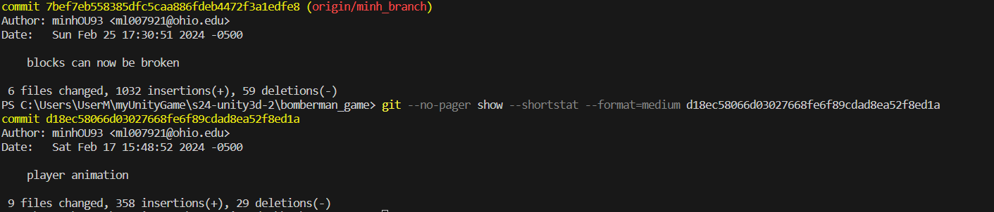
Minh Le (ml007921/minhOU93) -
Total Commits: 2
player animation · OU-CS3560/s24-unity3d-2@d18ec58 (github.com)
blocks can now be broken · OU-CS3560/s24-unity3d-2@7bef7eb (github.com)

Slide 26
Viet Huy Vu
Contributions
Finishing player movement
Placing bombs
Explosion triggered
Make player die if they were hit by the bomb
Things I learn:
Layers is a very important part of Unity. When making a game in Unity, a developer needs to be mindful about layering of render as sometimes a render just not show up because of the render order.
You can squash commit on your branch so it appears as one commit on main during merging

Slide 27
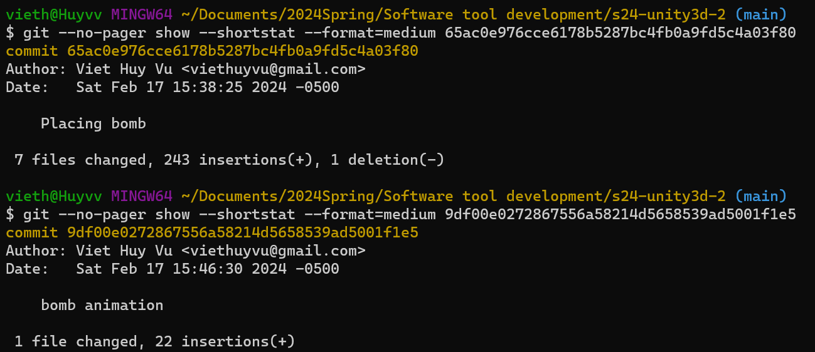
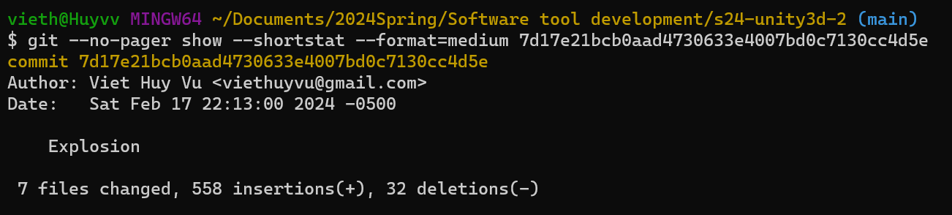
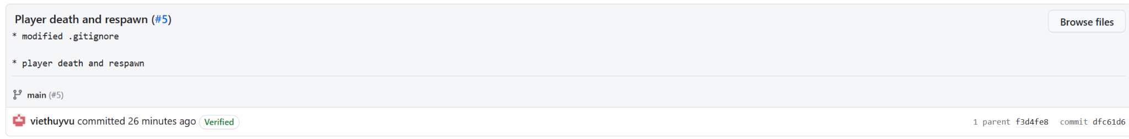
Viet Huy Vu (vv761622/viethuyvu) - Commits
Placing bomb · OU-CS3560/s24-unity3d-2@65ac0e9 (github.com)
bomb animation · OU-CS3560/s24-unity3d-2@9df00e0 (github.com)
Commits · OU-CS3560/s24-unity3d-2 (github.com)
Player death and respawn (#5) · OU-CS3560/s24-unity3d-2@dfc61d6 (github.com)

Slide 28
Tin Vuong
Contributions
Added a layer to the solid blocks so the pathfinding script can identify them as obstacles.
Finished the pathfinding script for enemies.
Learned to use the A* Pathfinding Project to make enemies move by watching a Youtube video and the project’s documentation.

Slide 29
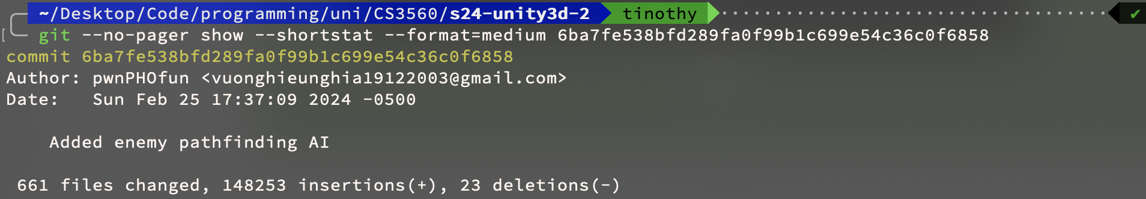
Tin Vuong (nv059721/wechicken456) - Commit 54
https://github.com/OU-CS3560/s24-unity3d-2/commit/6ba7fe538bfd289fa0f99b1c699e54c36c0f6858

Slide 30
Checkpoint 3

Slide 31
Past Work Summary
Minh - Implemented Title Screen, and play button
Huy - Finish player and enemy death state
Tin - Polished up AI movements, fixed bugs

Slide 32
Tools Used
Unity
Map Tool
Sprite Renderer
Astar Pathfinding Library
3rd party library to help with enemy AI.
Github:
Branches
Tags

Slide 33
Static Analysis:
FxCop
Static Analysis tool integrated with Visual Studio
Ran analysis on entire solution (all C# scripts, and libraries)
Many warnings and code style tips…

Slide 34
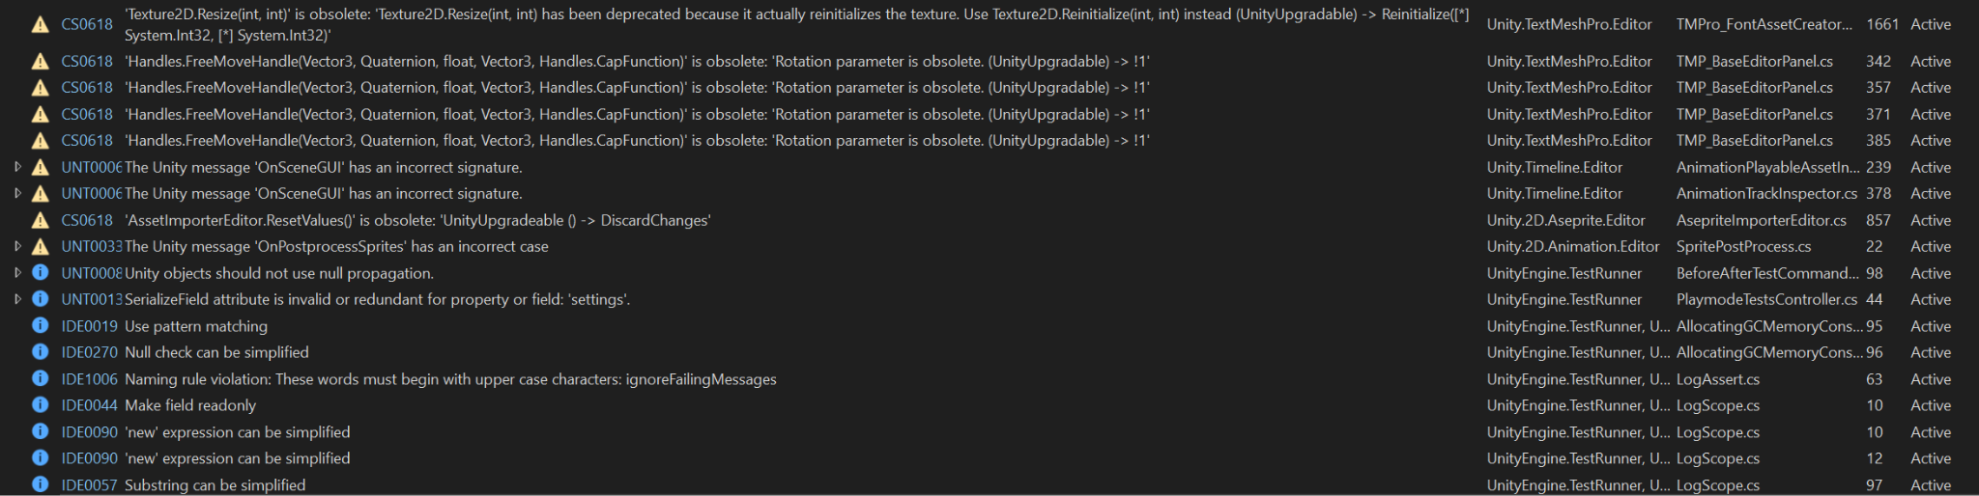

Slide 35
Next Checkpoint Plan
Tin: implement enemy animation, make enemy block player’s path.
Huy: Implement power ups
Minh: Work on capture the flag mechanic
Potential Roadblocks:
Potential merge issues, some content when merging main to a branch is left out.

Slide 36
Grading Items

Slide 37
Meeting Attendance Sheet
2/07/2024 – Tin missed (was sick)
2/10/2024 – All members attended
2/16/2024 - All attended
2/25/2024 - All attended
3/2/2024 - All attended
3/17/2024 - All attended
3/20/2024 - All attended

Slide 38
Minh Le Contributions
Created title screen and workable play button.
Report:
Scenes are important to navigate through different sections of the game like the title screen, main game, or different levels. There is an option to set the scene loading layer so that on button click a certain layer can be loaded in.

Slide 39
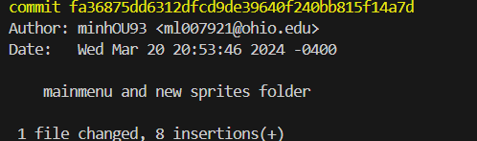
Minh Le (ml007921/minhOU93) - Commit
https://github.com/OU-CS3560/s24-unity3d-2/commit/fa36875dd6312dfcd9de39640f240bb815f14a7d

Slide 40
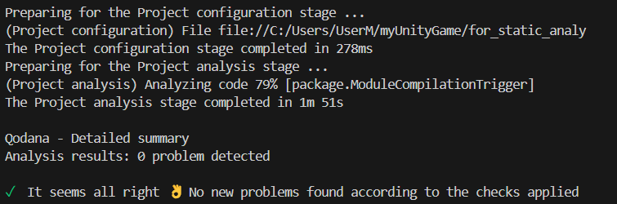
Minh Le
Static Analysis
Tool Used: Qodana. Different from the team because I wanted to try Qodana. Had to copy project to a public repo to get it to work tho.
Result: No problems found according to Qodana. No warnings either compared to the others. Couldn’t access the report because the localhost link would automatically shutdown.

Slide 41
Viet Huy Vu
Contributions
Polished player and enemy death state.
Started working on Powerup
Trying to design final version of the game

Slide 42
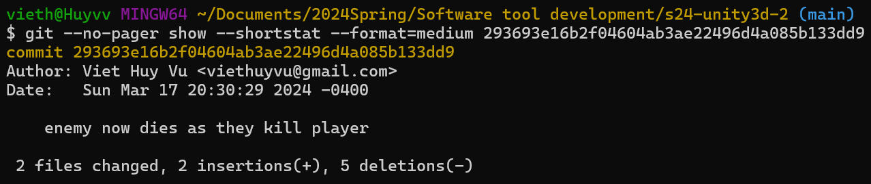
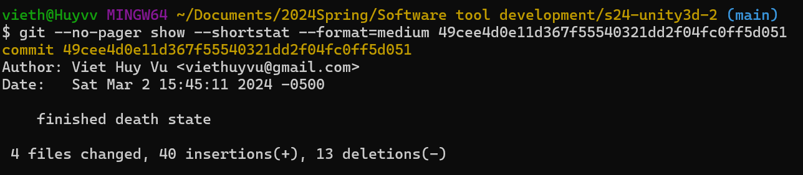
Viet Huy Vu (vv761622/viethuyvu) - Commits
enemy now dies as they kill player · OU-CS3560/s24-unity3d-2@293693e (github.com)
finished death state · OU-CS3560/s24-unity3d-2@49cee4d (github.com)

Slide 43
Viet Huy Vu
Static Analysis
Tool Used: Microsoft Visual Studio Built in Static Analysis: FxCop. Main reason for using it is that it was already on my machine.
Result: Many warnings but no major issues. Warnings were from packages being outdated, but those are not an issue.

Slide 44
Tin Vuong
Contributions
Polished up AI movements
Fixed map and enemy collision
Fixed more bugs

Slide 45
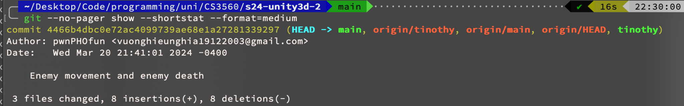
Tin Vuong (nv059721/wechicken456) - Commit
https://github.com/OU-CS3560/s24-unity3d-2/commit/4466b4dbc0e72ac4099739ae68e1a27281339297

Slide 46
Tin Vuong
Static Analysis
Tool Used: FxCop, also had visual studio so did it together with Huy.
Result: Results were the same as Huy, many warnings but nothing major.

Slide 47
Checkpoint 4

Slide 48
Past Work Summary
Minh - Add new sprites, Menu UI, Game UI, End Screen
Huy - Add Powerups, Pause Menu and Quit Game option. Deployment
Tin - Enemy Movement

Slide 49
Tools Used
Unity
Map Tool
Sprite Renderer
Astar Pathfinding Library
3rd party library to help with enemy AI.
Github:
Branches
Tags
VSCode static analyzer

Slide 50
Next Checkpoint Plan
Tin:
Polish pathfinding for enemy.
Add random to some enemies and raycasting for them.
Huy: More Dynamic Map (one of these options)
Map editor
Random map creation
Minh:
Work on CTF mechanics
Potential Roadblocks:
Map editor is quite complicated.

Slide 51
Grading Items

Slide 52
Meeting Attendance Sheet
2/07/2024 – Tin missed (was sick)
2/10/2024 – All members attended
2/16/2024 - All attended
2/25/2024 - All attended
3/2/2024 - All attended
3/17/2024 - All attended
3/20/2024 - All attended
3/23/2024 - All attended
3/30/2024 - All attended
4/4/2024 - All attended

Slide 53
Minh Le Contributions
Add new sprites and various UI elements
Game Death Counter
End Game Condition

Slide 54
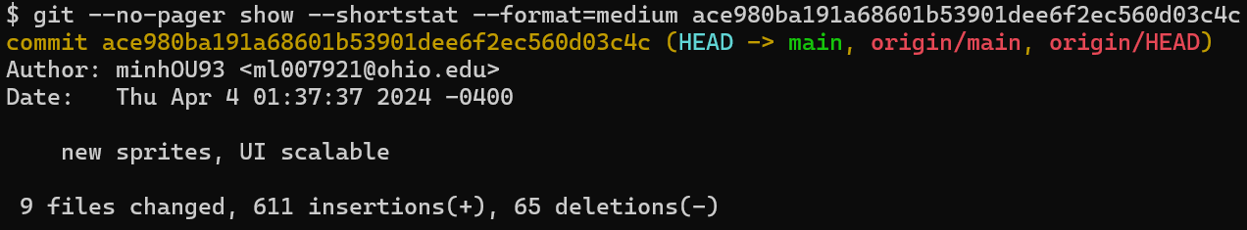
Minh Le (ml007921/minhOU93) - Commit 140
new sprites, UI scalable · OU-CS3560/s24-unity3d-2@ace980b (github.com)

Slide 55
Viet Huy Vu
Contributions
Add in 4 Powerups
Add quit option to main menu
Add pause menu

Slide 56
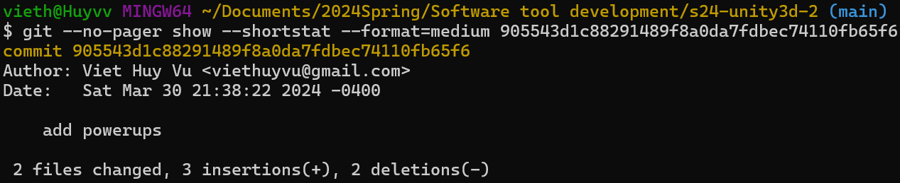
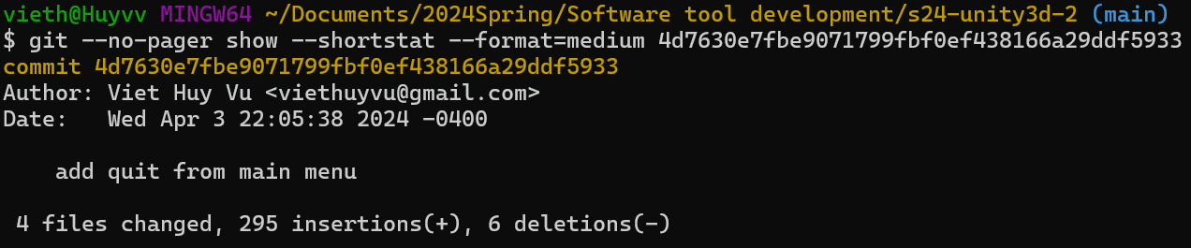
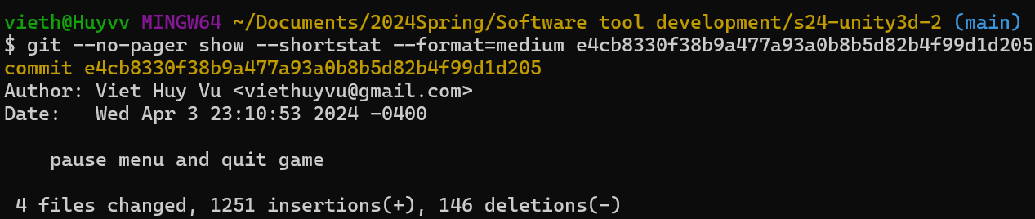
Viet Huy Vu (vv761622/viethuyvu) - Commits
add powerups · OU-CS3560/s24-unity3d-2@905543d (github.com)
add quit from main menu · OU-CS3560/s24-unity3d-2@4d7630e (github.com)
pause menu and quit game · OU-CS3560/s24-unity3d-2@e4cb833 (github.com)

Slide 57
Tin Vuong
Contributions
Fixed enemy spawning mechanism.
Added the feature: spawn an “ally” enemy when a player takes a powerup.
Made enemy chase different players depending on which player took the powerup.

Slide 58
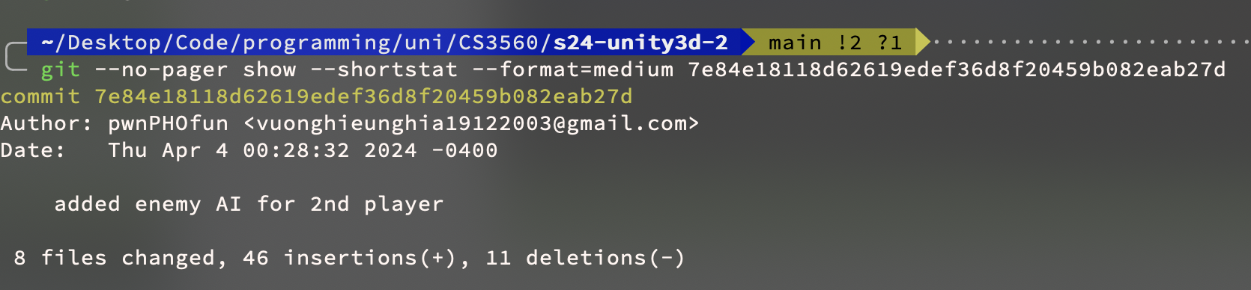
Tin Vuong (nv059721/wechicken456) - Commit
https://github.com/OU-CS3560/s24-unity3d-2/commit/7e84e18118d62619edef36d8f20459b082eab27d

Slide 59
Checkpoint 5

Slide 60
Semester Work Summary
Minh - Art Direction, Menu UI, Game UI, End Screen, Timer, Map Creation.
Huy - Player movement, Bomb placement, Explosion, Death, Powerups, Pause Menu, Quit Game option, Sounds. (Thank you Eli for making the music <3)
Tin - Enemy Movement, Enemy Pathing, Enemy Behavior, AI bug fixing.

Slide 61
Tools Used
Unity
Map Tool
Sprite Renderer
Sprite modifier
Unity Testing Framework: NUnit
Astar Pathfinding Library
3rd party library to help with enemy AI.
Github:
Branches
Tags
Visual Studio
Static Analyser
Git managing tool

Slide 62
Teamwork Reflection
Tin:
I had LOADS of fun. Learned about Unity, C#, Git, and team-based problem solving.
Huy: It was great! No Problem!
Minh: I had fun, we accomplished a lot but there will always be things to improve on (different game modes, randomly generated maps).

Slide 63
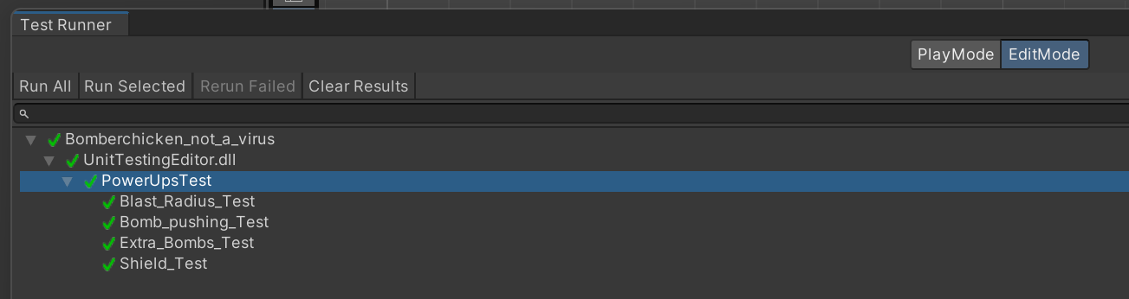
Unit Testing - Huy
Tool: Unity Test Framework - Come with Unity
Test cases: I used it to test my Item Pick Up function with 4 test cases representing each scenario of an item being picked up

Slide 64
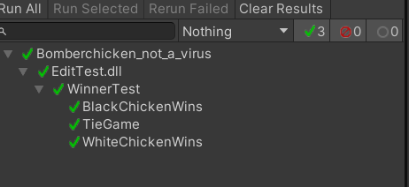
Unit Testing - Minh
Tool: Unity Test Framework - Come with Unity
Test cases: 3 test cases to test the different win states.
Player 1 wins (player 2 had more deaths)
Player 2 wins (player 1 had more deaths)
Tie (same deaths)

Slide 65
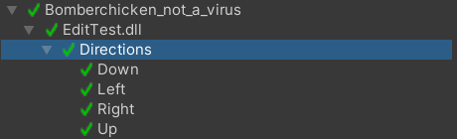
Unit Testing - Tin
Tool: Unity Test Framework - Come with Unity
Test cases: 4 test cases to test if our directions equal the correct Vector representation.
Up
Down
Left
Right

Slide 66
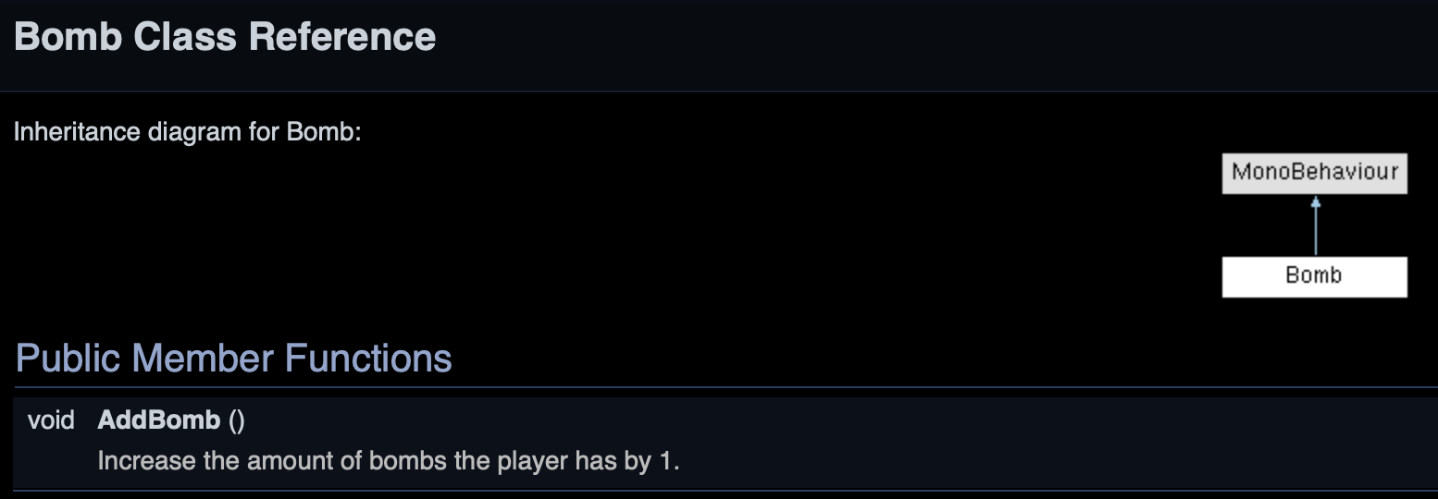
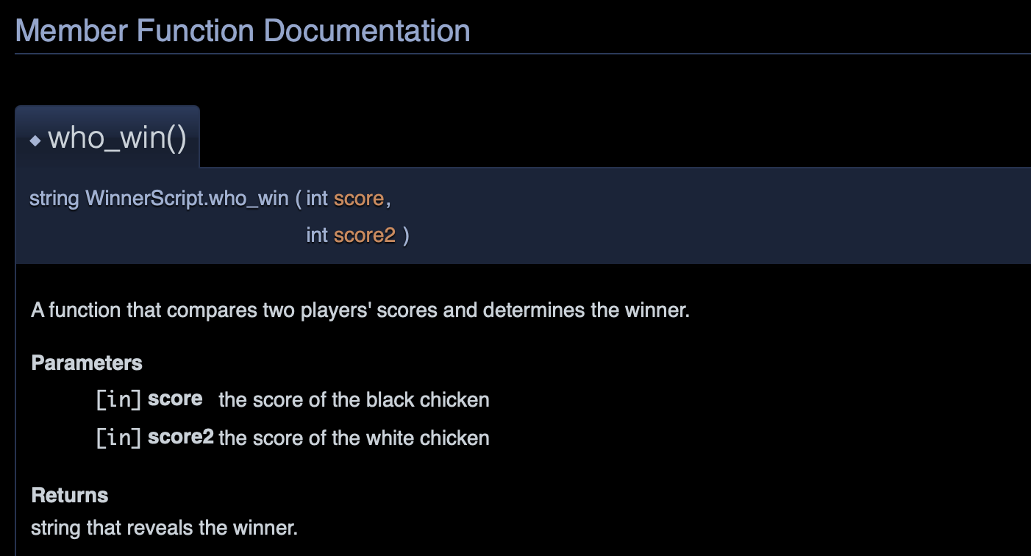
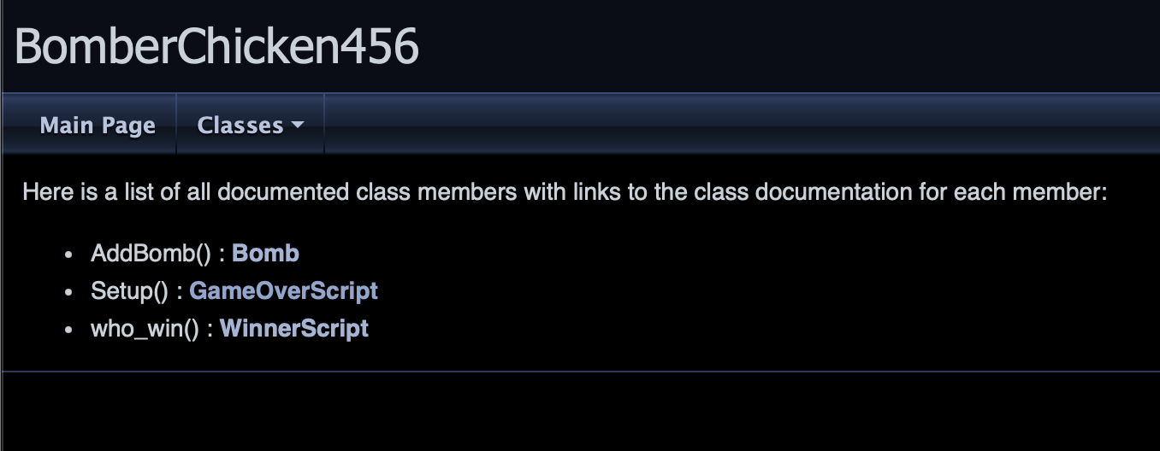
Documentation
Tool: Doxygen

Slide 67
Grading Items

Slide 68
Release Info
Method of Release: GitHub release that includes an executable file to play the game.
Release Bomber Chicken Full Release · OU-CS3560/s24-unity3d-2 (github.com)

Slide 69
Meeting Attendance Sheet
2/07/2024 – Tin missed (was sick)
2/10/2024 – All members attended
2/16/2024 - All attended
2/25/2024 - All attended
3/2/2024 - All attended
3/17/2024 - All attended
3/20/2024 - All attended
3/23/2024 - All attended
3/30/2024 - All attended
4/4/2024 - All attended
4/17/2024 - All attended
4/22/2024 - All attended

Slide 70
Minh Le Contributions
Add new sprites and updated UI elements
Countdown Timer
Scrolling Backgrounds

Slide 71
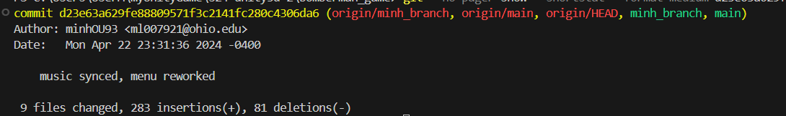
Minh Le (ml007921/minhOU93) - Commit 157
music synced, menu reworked · OU-CS3560/s24-unity3d-2@d23e63a (github.com)

Slide 72
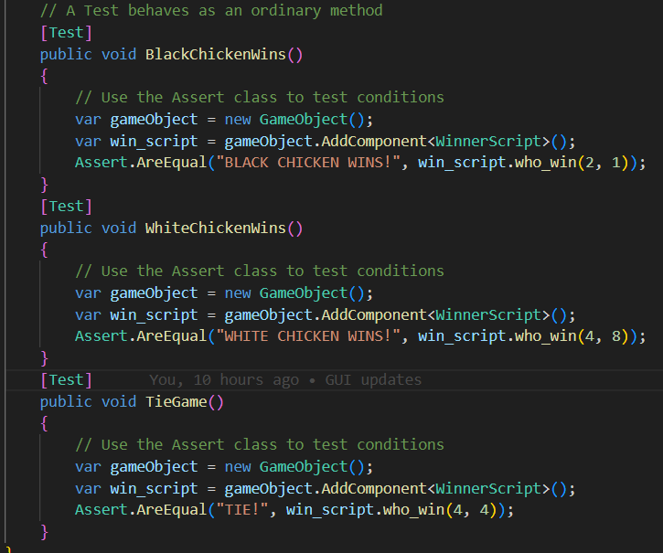
Minh Le
Unit Testing Implementation
Reasoning behind inputs:
To win the game, the other player has to have more deaths than you. In the function who_win, it takes two integer values, the first is the 1st player deaths, and the second is the 2nd player’s deaths. If the 1st player’s death is greater than the 2nd player’s death, then the output should be the second player wins (BLACK CHICKEN WINS!). Same logic for the other player.

Slide 73
Minh Le
Unit Testing Result

Slide 74
Viet Huy Vu
Contributions
Add sounds
Fixed Screen Resolution issues
Added music to the different scenes

Slide 75
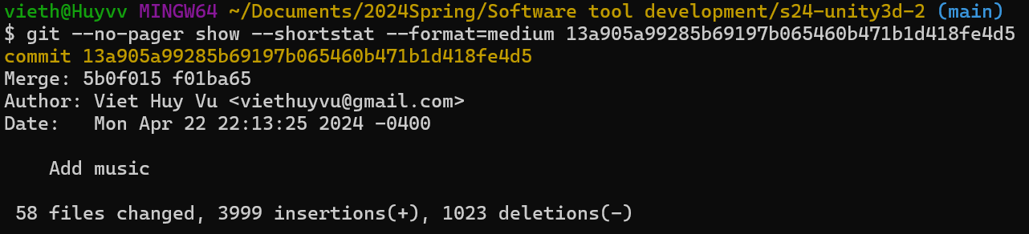
Viet Huy Vu (vv761622/viethuyvu) - Commits
Add music · OU-CS3560/s24-unity3d-2@13a905a (github.com)

Slide 76
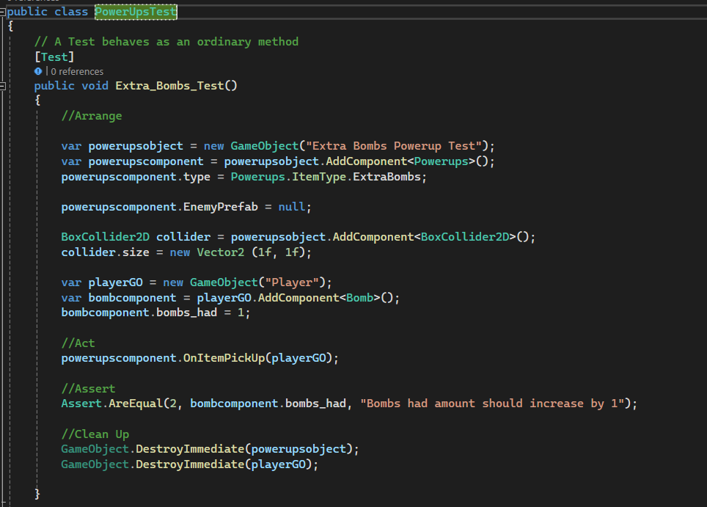
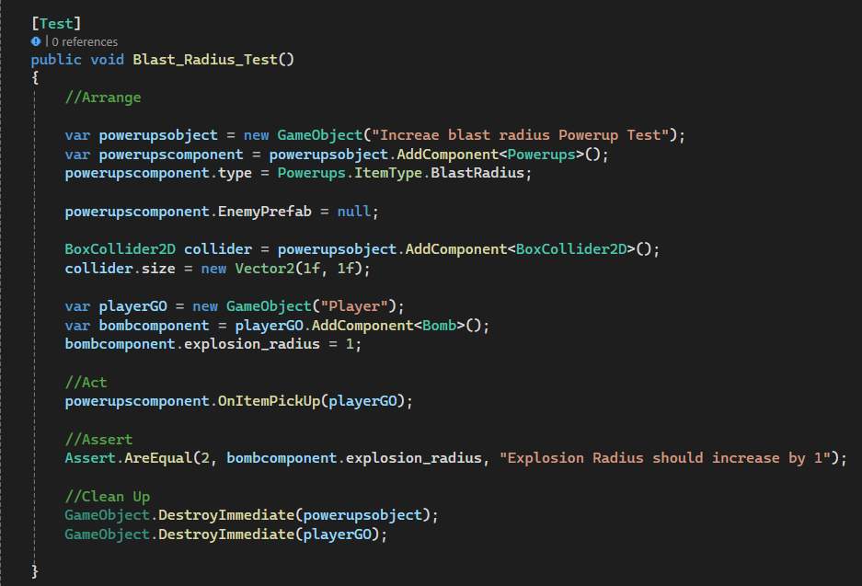
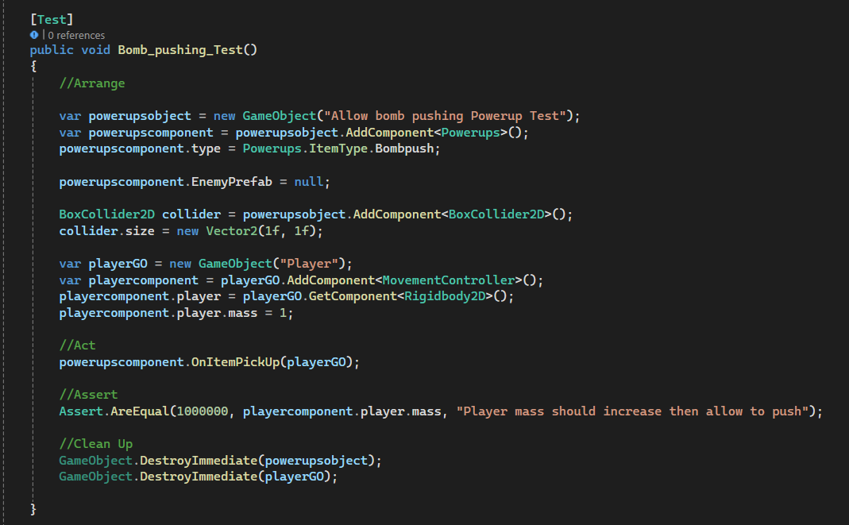
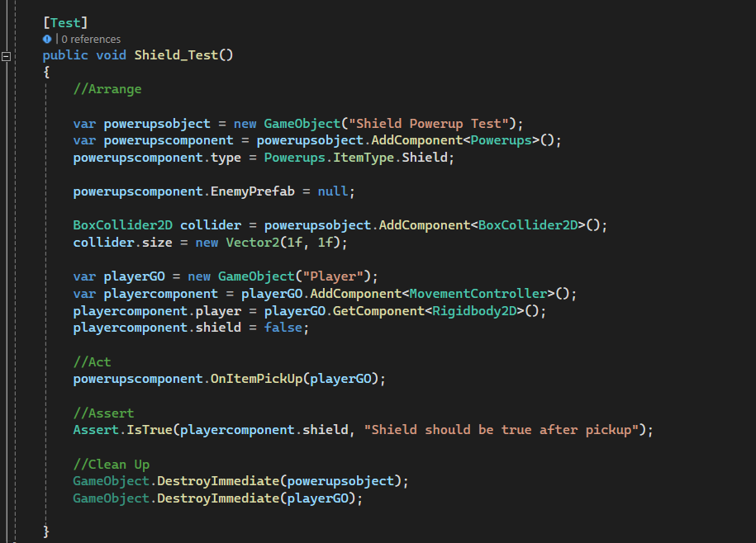
Viet Huy Vu
Unit Testing Implementation

Slide 77
Viet Huy Vu
Unit Testing Result

Slide 78
Tin Vuong
Contributions
Added doxygen documentation
Worked with Minh to create enemy sprite movement animation.
Unit testing.

Slide 79
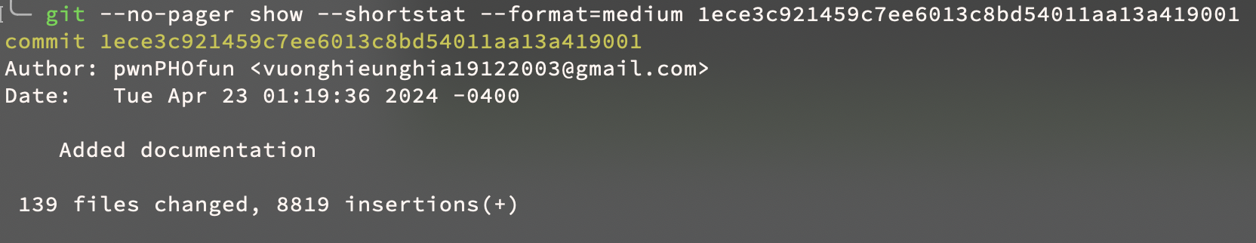
Tin Vuong (nv059721/wechicken456) - Commit
https://github.com/OU-CS3560/s24-unity3d-2/commit/1ece3c921459c7ee6013c8bd54011aa13a419001

Slide 80
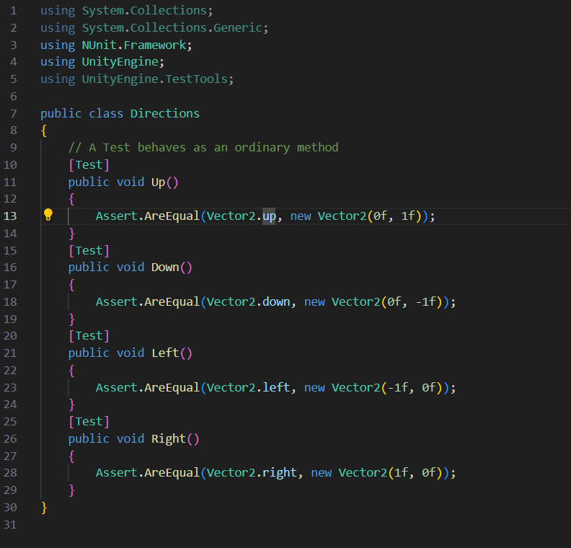
Tin Vuong
Unit Testing Implementation

Slide 81
Tin Vuong
Unit Testing Result

